Slide 1

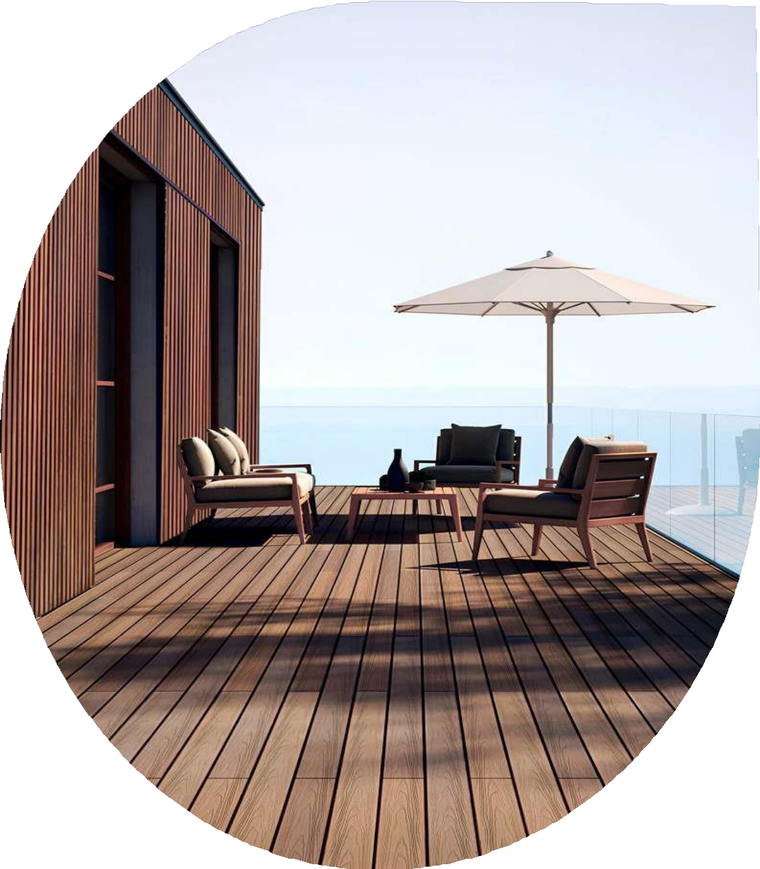
MAKE MORE OF THE
OUTDOORS
E N G I N E E R E D HIGH P E R F O R M A N C E W O O D - P O LY M E R C E L L U L O S E P L A N K S

Slide 2
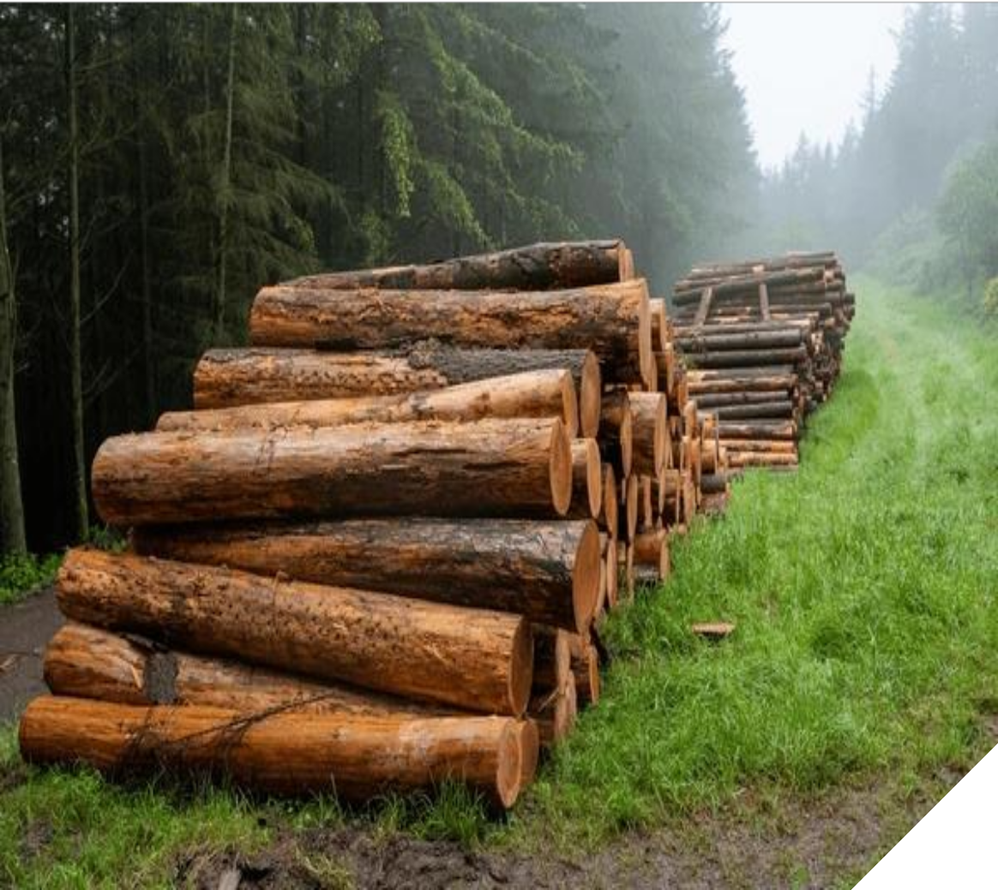

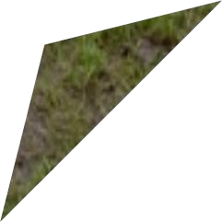




AN ALL WEATHER CHAMPION
India being a Country of weather extremes, requires a material that performs well in all climate conditions. From heat waves to cold winters, variations in rainfall, temperatures and humidity are abnormal. Exteriors require an exceptionally durable & high performing material to endure extreme weather conditions. The inherent characteristics of Stemwud WPC makes it durable, all weather resistant and the best suited material for exteriors.
ENVIRONMENTALLY SUSTAINABLE ARCHITECTURAL SOLUTIONS
Stemwud WPC is a combination of recycled wood flour and HDPE thermoplastics. Nearly 90% of the raw material in Stemwud WPC are from secondary sources, that would either be dumped in landfills or burnt.
The environmental impact in manufacturing Stemwud WPC is negligible with the consumption of high volume recycled non toxic raw materials combined with a production process free of toxic emissions or effluent discharge.
The outcome however is an exceptionally durable, cost efficient and low environmentally impact material, offering superlative aesthetic appeal with remarkable weathering performance.
WEATHER PROOF
ANTI FADING
LOW MAINTENANCE
TERMITE PROOF
HIGH STRENGTH
ANTI CORROSIVE
FIRE RETARDANT

Slide 3
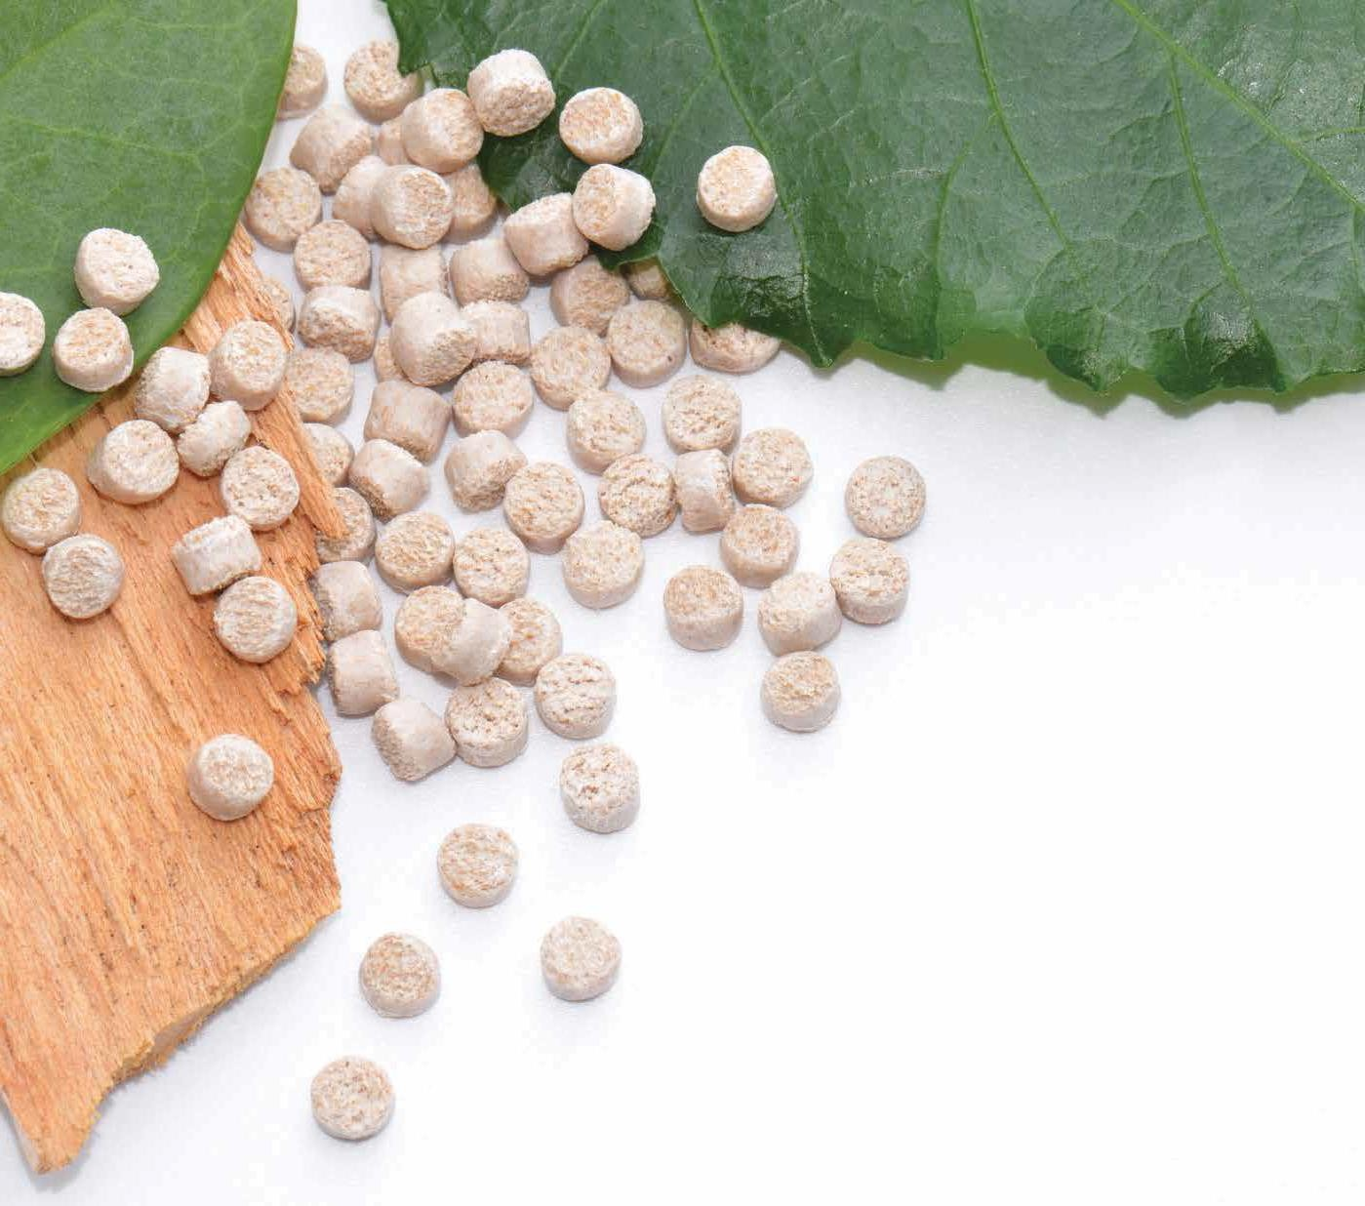
Wood Polymer Cellulose
The ability to craft and use high quality materials for a structure convey sentiments and encourage new ideas. New age design enthusiasts with time have come to appreciate engineered high-performance composite materials for specific geographical locations and uses. With this brochure we showcase the inventive and technical constituents of our WPC extrusions for outdoor and indoor use and simplify in understanding the importance of balancing utility, functionality and aesthetics – all at the same time!

Slide 4
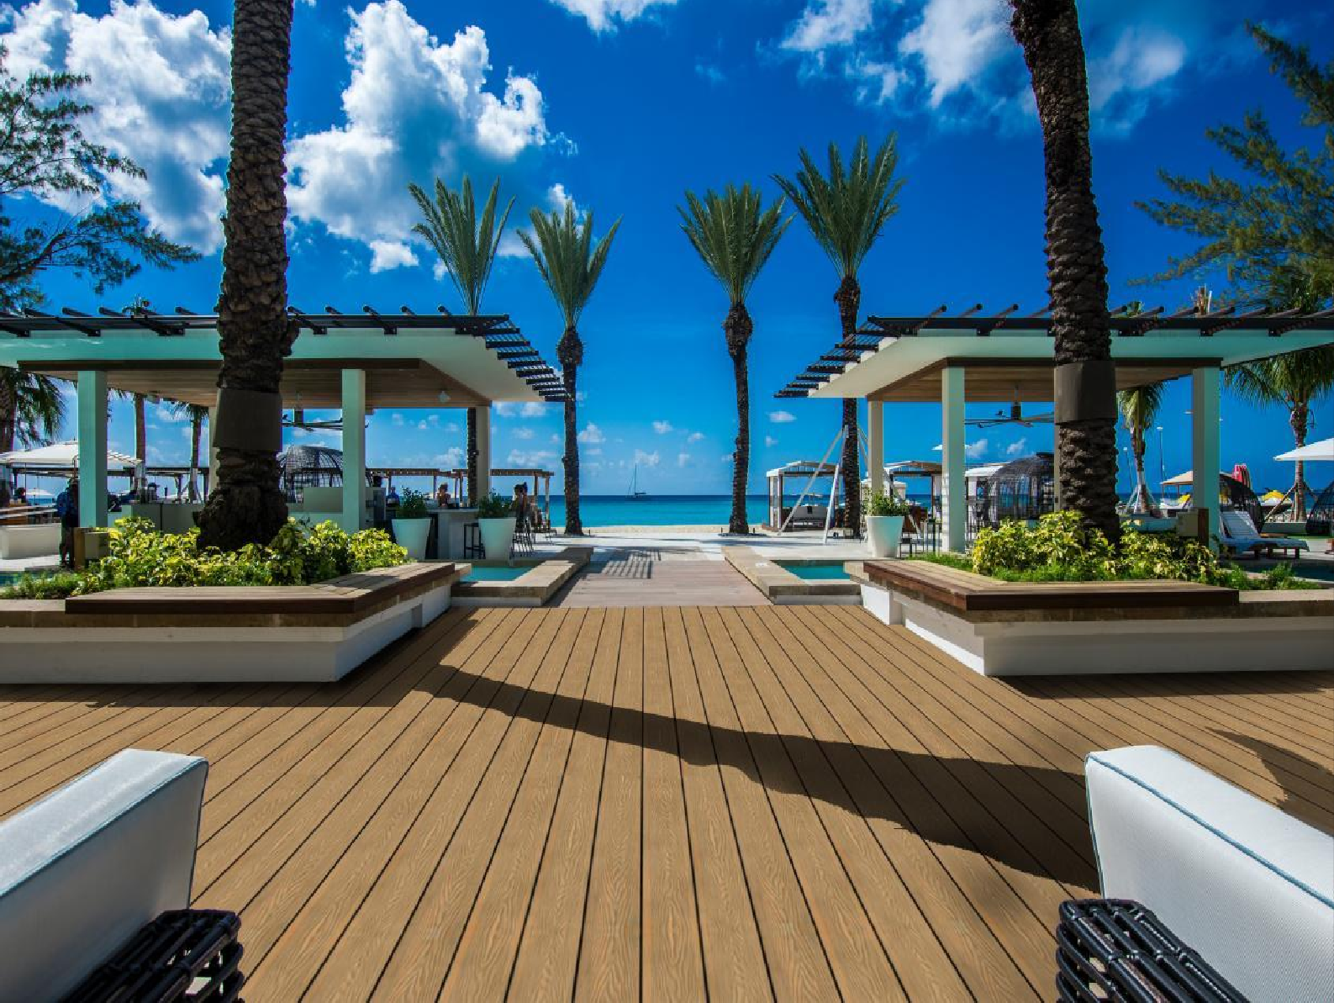
Get more from your outdoor space. Our Stemwud Wood Polymer Cellulose decking boards provide a natural-looking, long lasting and easy to maintain low-slip surface for outdoor areas. Patios, pool sides, walkways and roof terraces can all benefit from our decking.
Our Stemwud decking boards feature a hollow core construction and are suitable for domestic and commercial use. They are an attractive modern alternative to traditional timber boards that can split and warp and require expensive on-going rot-prevention treatment.
Installed over an anticorrosive aluminium framework with concealed fixtures and no exposed hardware. Stemwud decking is completely barefoot safe. A sustainable solution to wood decking, Stemwud decking is cost effective with low lifetime costs owing to no maintenance over it’s
lifetime.
3

Slide 5
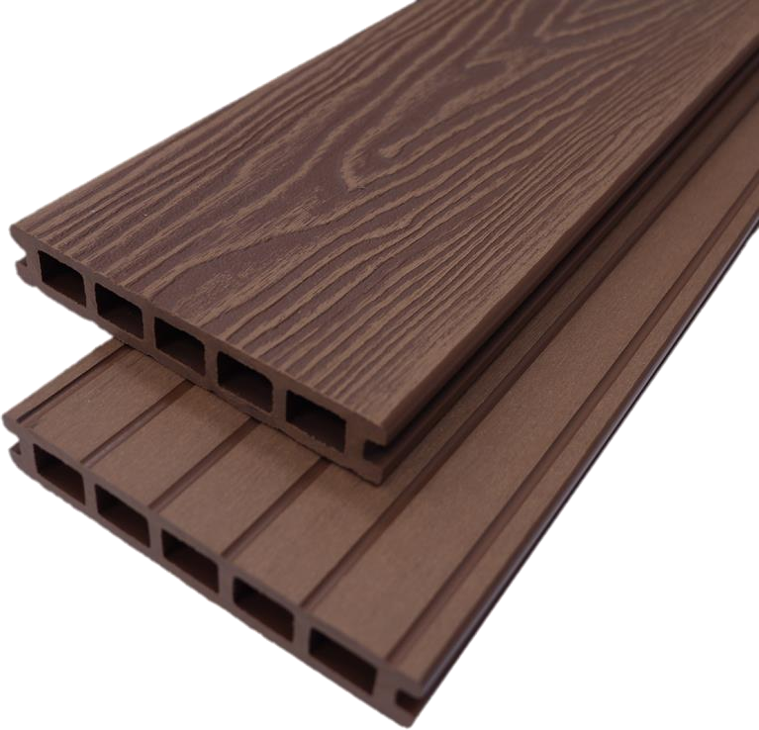

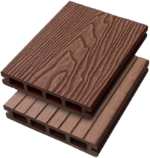
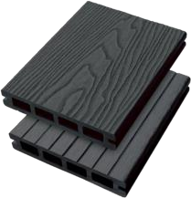
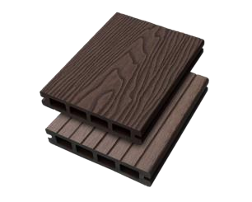
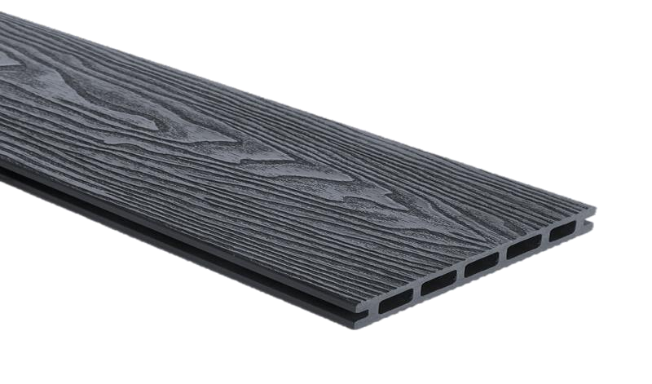
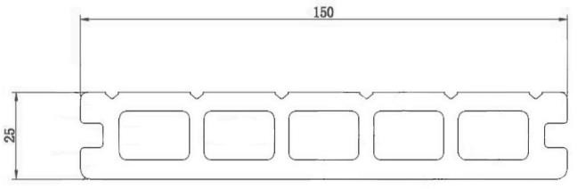
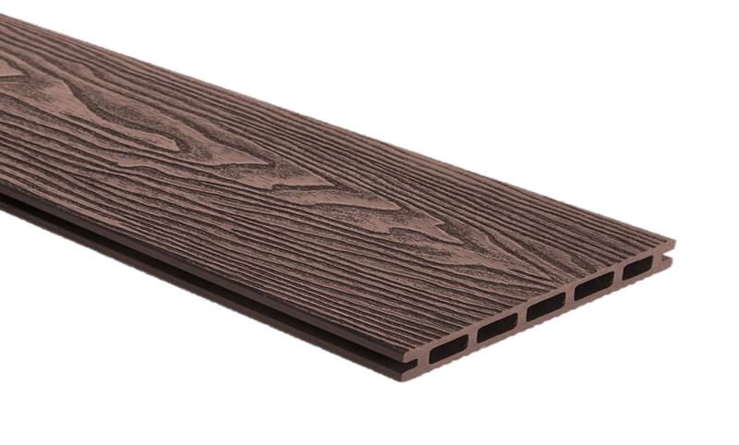
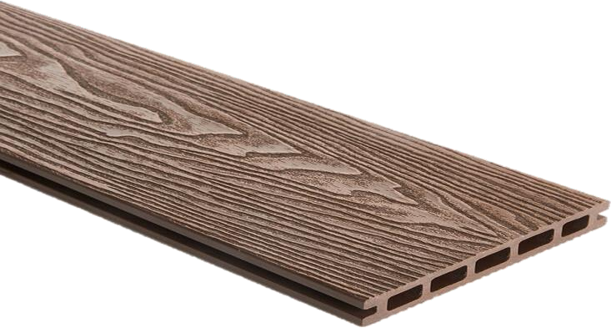
STEM W U D C L A SSIC D E C K ING
Size: 150 x 25 x 2900 m m
Color options
SWD201
Teak
SWD202
D.Grey
SWD203
Chocolate
S P E C I F I C A T I O N S & DIMENSIONS
Area per panel | 4.68 sq.ft.
Area per Box | 23.40 sq.ft.
Pcs per Box | 5 Pcs

Slide 6

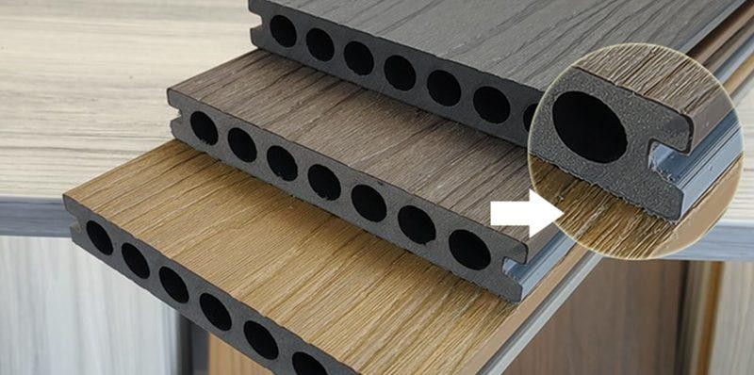
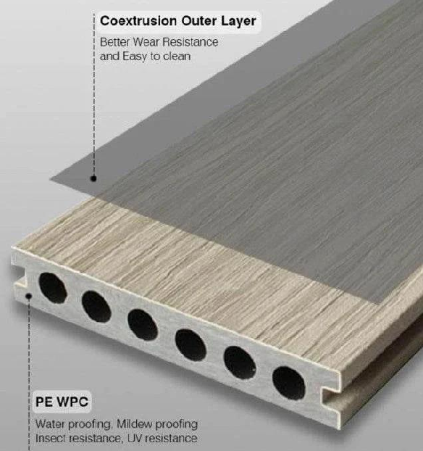
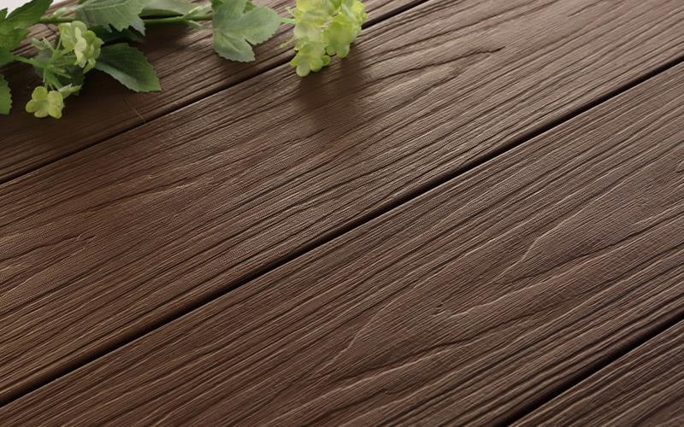
STE M W U D L U X E D E C K ING
Stemwud Luxe WPC co-extrusion is a manufacturing technique that combines wood fiber powder, plastic, and additives to create a composite material with a protective outer layer. The co-extrusion process produces a solid board with a uniform coating that makes the material more durable and weather resistant.

Slide 7
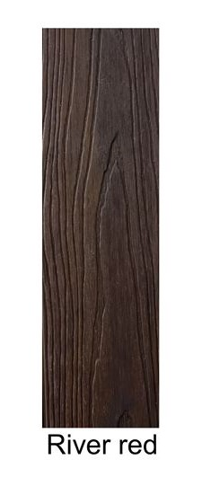
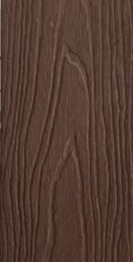
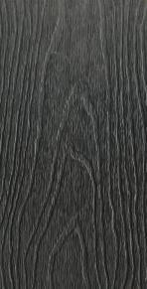
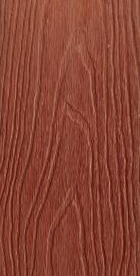
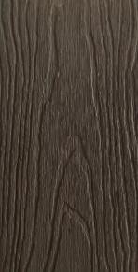
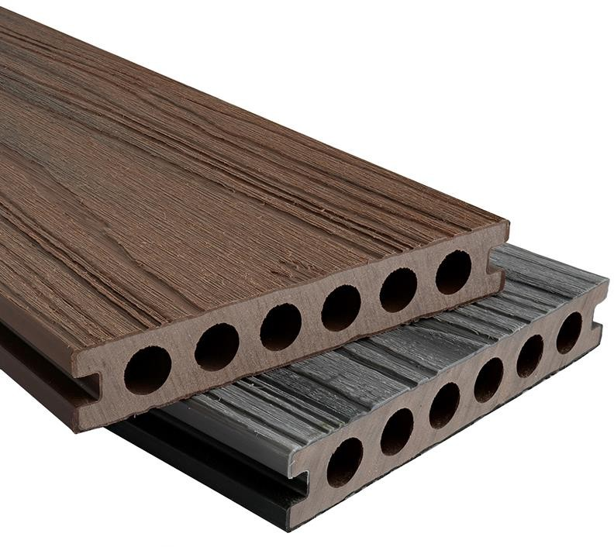
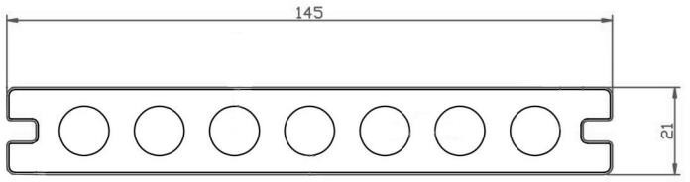
STE M W U D L U X E D E C K ING
( C o - e x t r u d e d d u a l l a y e r )
Size: 145 x 21 x 290 0 m m
Color options
SWCD 401
RIVER RED / IRON WOOD
SWCD 402
ROSE WOOD / BROWN
S P E C I F I C A T I O N S & DIMENSIONS
Area per panel | 4.53 sq.ft.
Area per Box | 22.65 sq.ft.
Pcs per Box | 5 Pcs

Slide 8
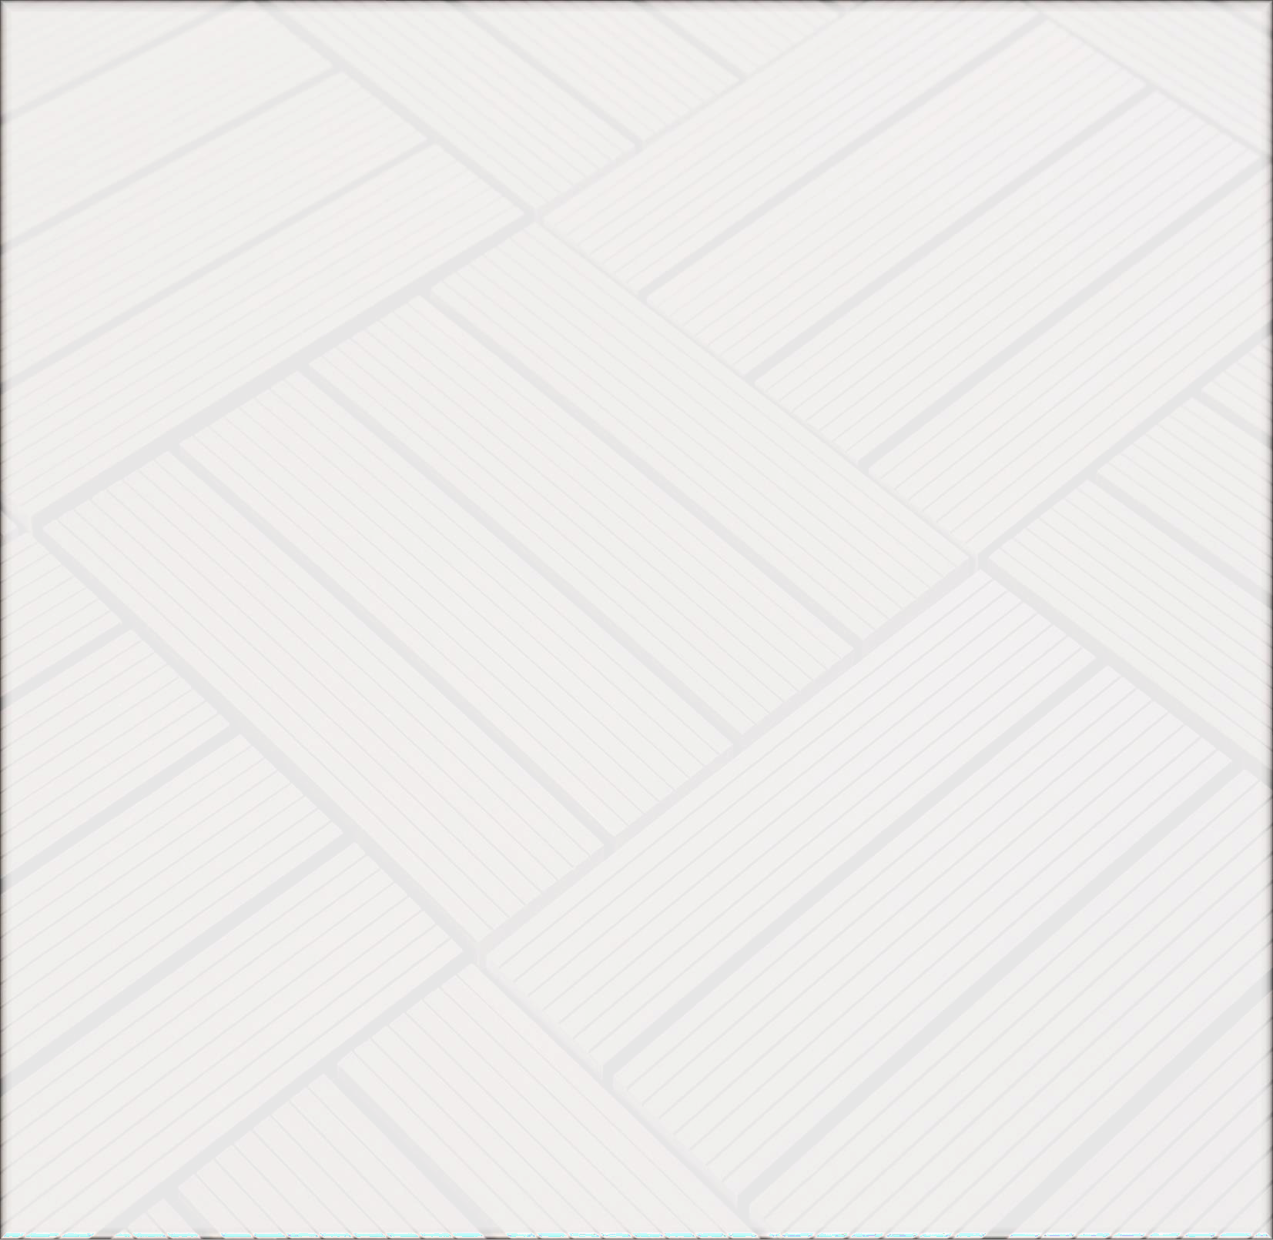
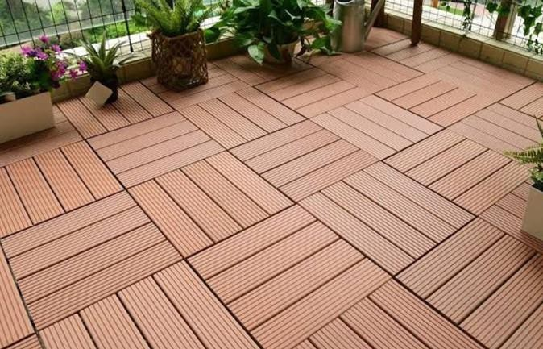
STEMWUD DECK TILES
Stemwud WPC decking tiles are modern flooring materials for outdoor use. They consist of a combination of wood polymer cellulose, pressed together at high temperatures and pressures, and applied to a backing plate with a click system. This results in a very easy-to-maintain and extremely durable surface with excellent aesthetics.
WPC decking tiles are easy to lay and quickly achieve the desired result when laying interlocking tiles. The click system provides a simple yet secure connection between the elements. Additional fastening to the ground with screws, nails, or adhesive is neither planned nor necessary.
The material and specific structure of WPC decking tiles and wood tiles with a click system require an absolutely flat and dry substrate. Unevenness in the surface must be avoided as well as persistent moisture or standing water. To ensure drainage of rainwater and dew, the entire surface should have a slope of about two percent. Proper drainage of rain or dew is recommended. Suitable substrates are preferably concrete screed or solid surfaces sealed with plastic.
7

Slide 9
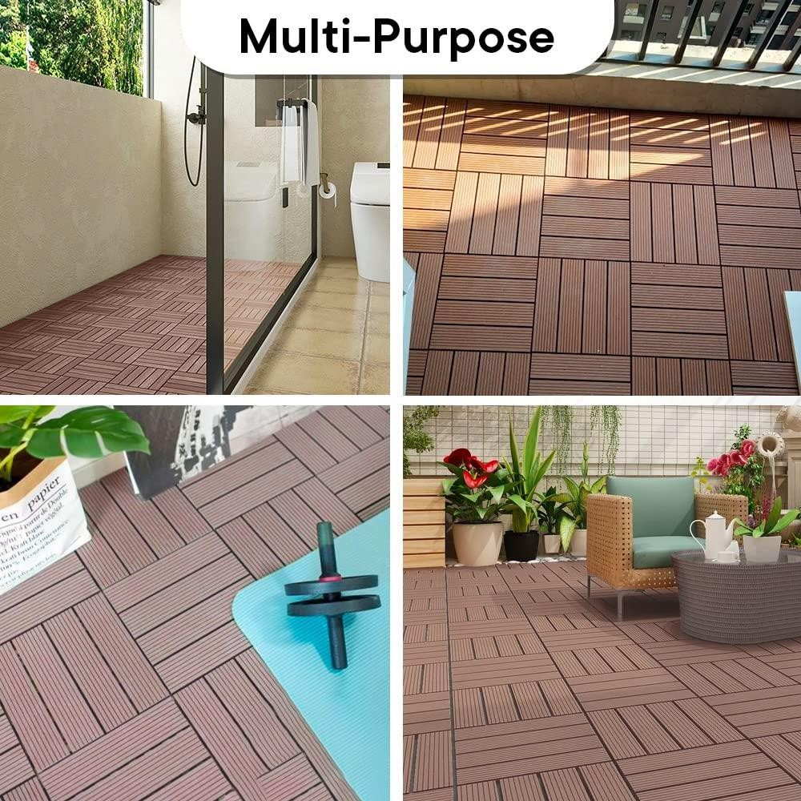
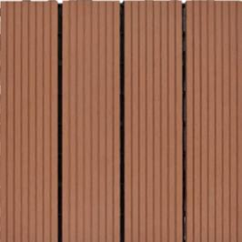
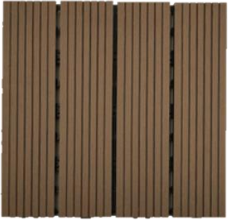
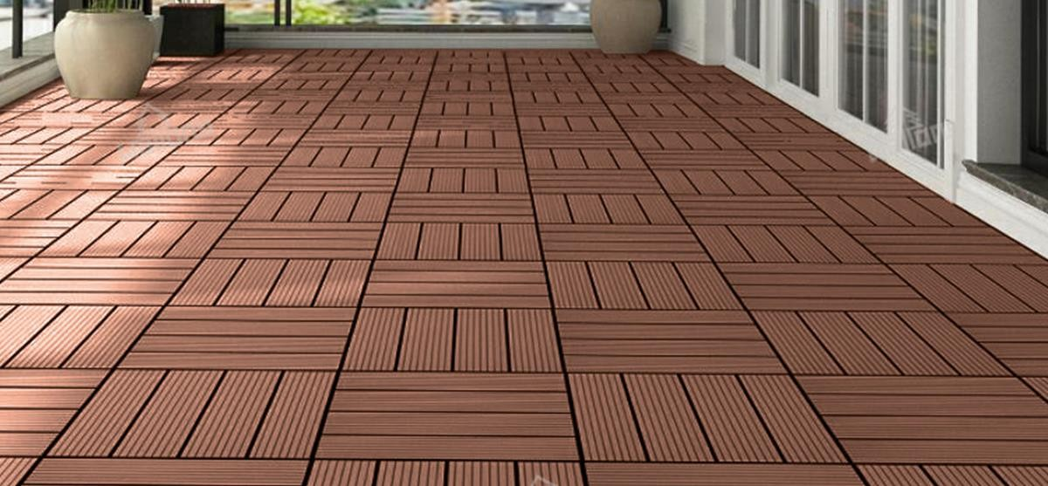
S T E M W U D DIY D E C K T I L E S
Size: 300 x 300 x 22 mm
Color options :
SWT 601
POLAND RED WOOD
SWT 602
POLAND BROWN
Area per tile | 0.97 sq.ft.
Area per Box | 9.69 sq.ft.
Pcs per Box | 10 Pcs
8

Slide 10

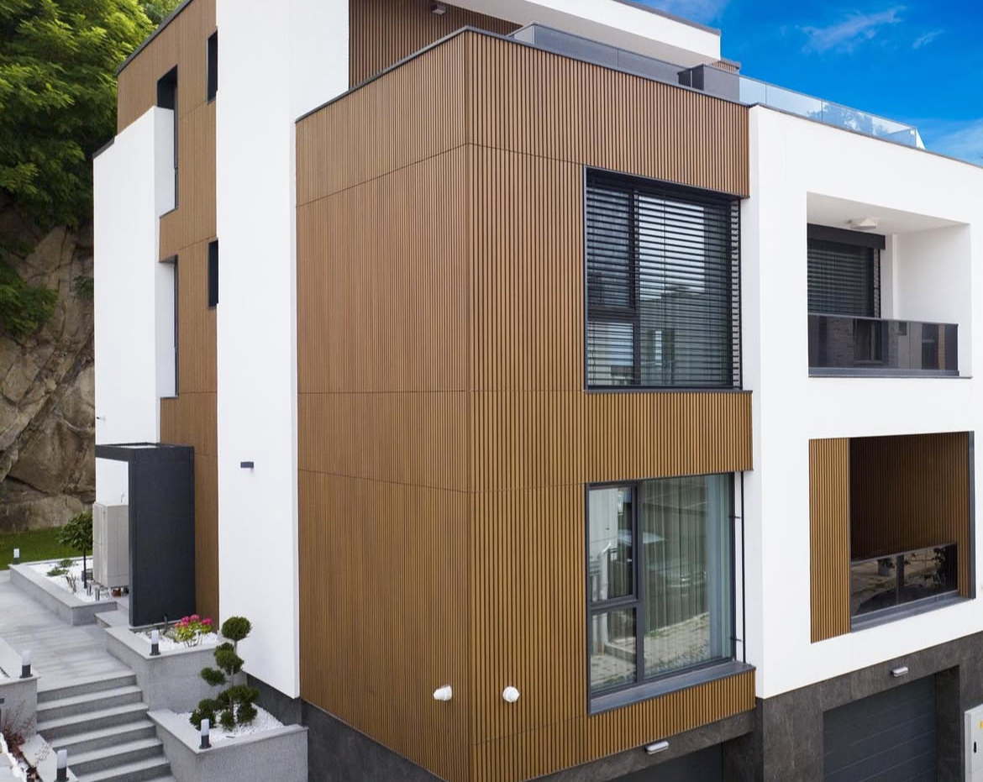
Our Stemwud Wood Plastic Composite Co-extruded Louver boards provide a natural-looking, long lasting and easy to maintain low-slip surface for outdoor areas. Exterior facade cladding, ceiling and gates can all benefit from our Louvers.
Our Stemwud Louvers boards feature a hollow core construction and are suitable for domestic and commercial use. They are an attractive modern alternative to traditional timber boards that can split and warp and require expensive on-going rot-prevention treatment.
9

Slide 11
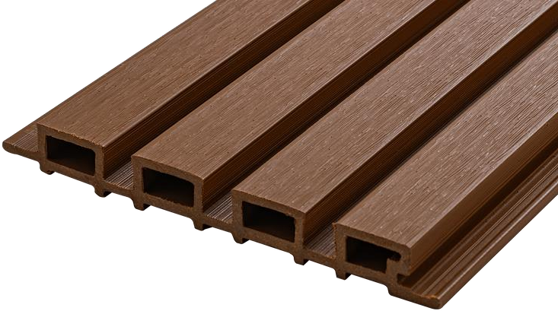
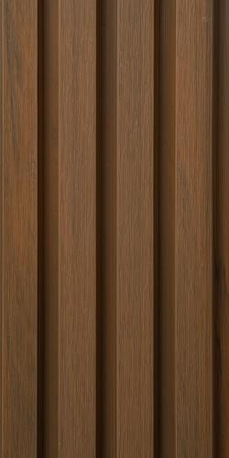
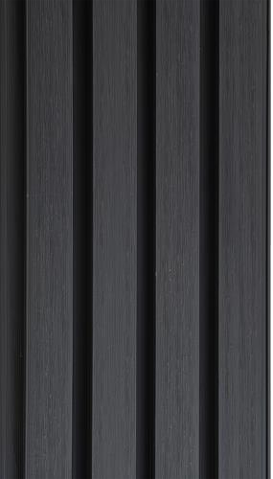
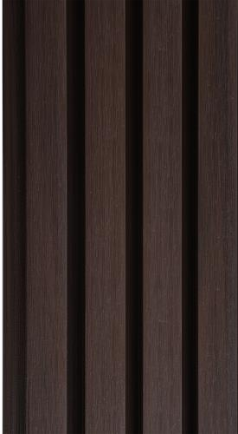
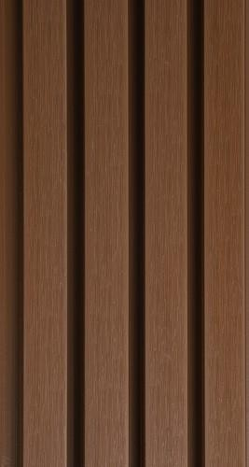
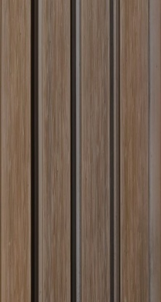
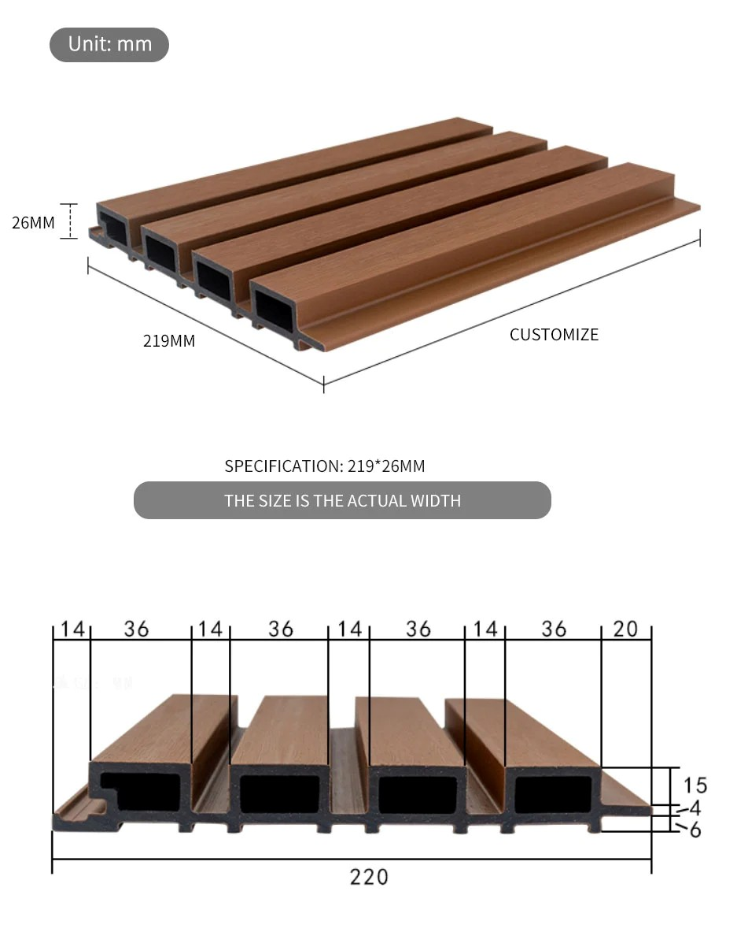
STEMWUD PRIME FLUTED PANEL
Size: 219 mm x 2 6 mm x 2 9 0 0 m m
Color options
SWL101Teak
SWL102
D.Grey
SWL103
IPE
SWL104
Oak
SWL106
Walnut
Area Per Panel | 6.84 Sqft
Area Per Pack | 34.20 Sqft
Pcs per Pack | 5 Pcs
10

Slide 12
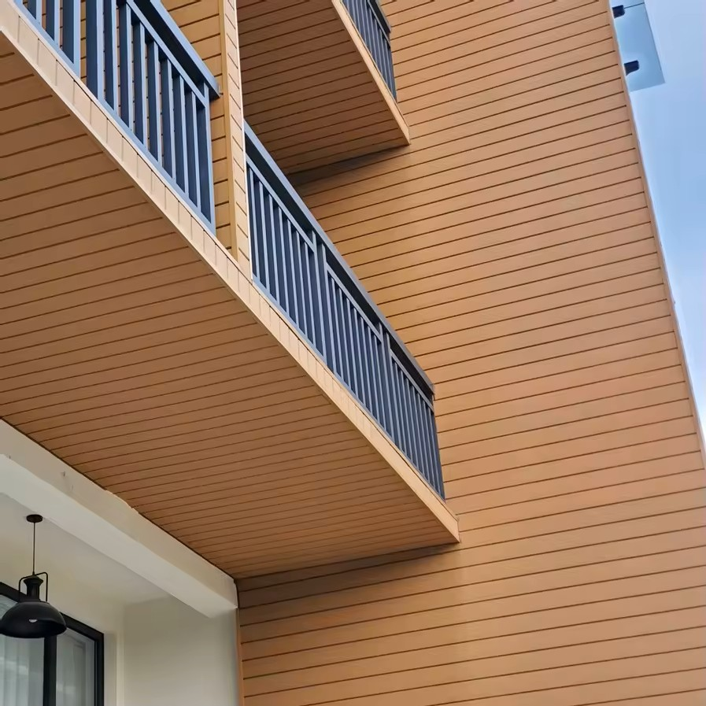
Our Stemwud Wood Plastic Composite Co-extruded outdoor cladding offers a compelling alternative to traditional cladding materials, providing both a classic aesthetic and exceptional performance. This innovative material combines the beauty of natural wood with the resilience of plastic, making it a popular choice for enhancing the exterior of residential and commercial buildings.
11

Slide 13
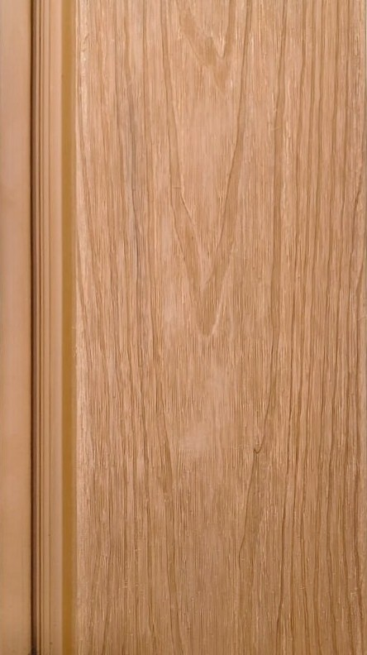
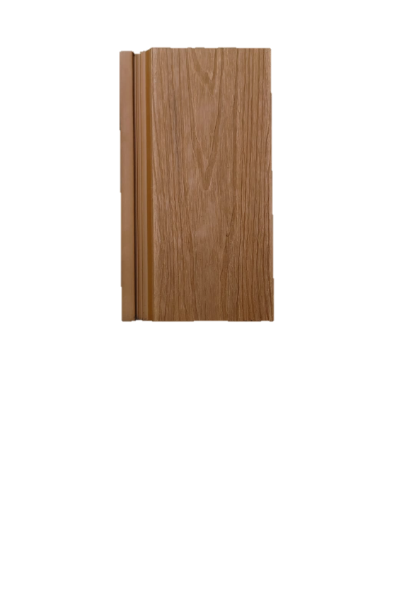
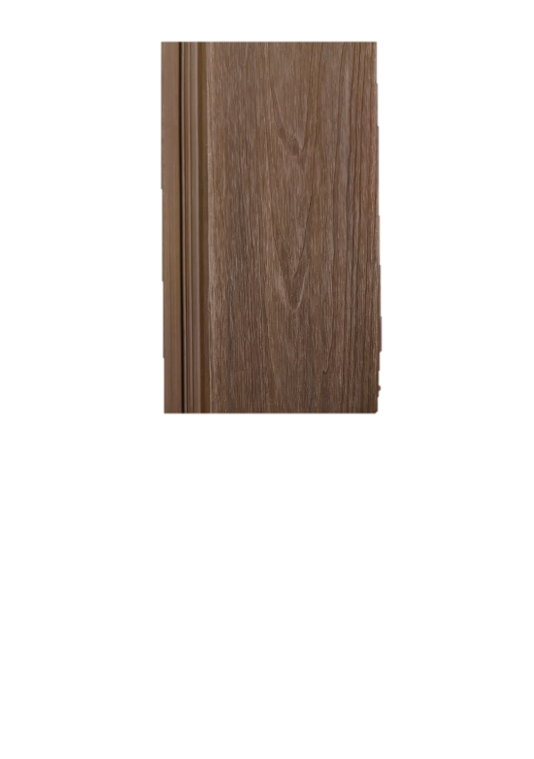
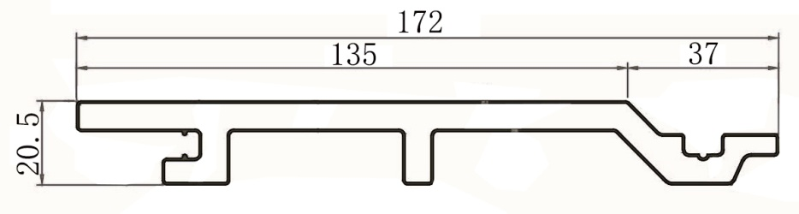
STEMWUD AURA CLADDING
Size: 172 mm x 2 0.5 mm x 2 9 0 0 m m
Color options
OAK
BROWN
Area per panel | 5.37 Sq Ft
Area per pack | 26.85 Sq Ft
Pcs per pack | 5 Pcs
12

Slide 14
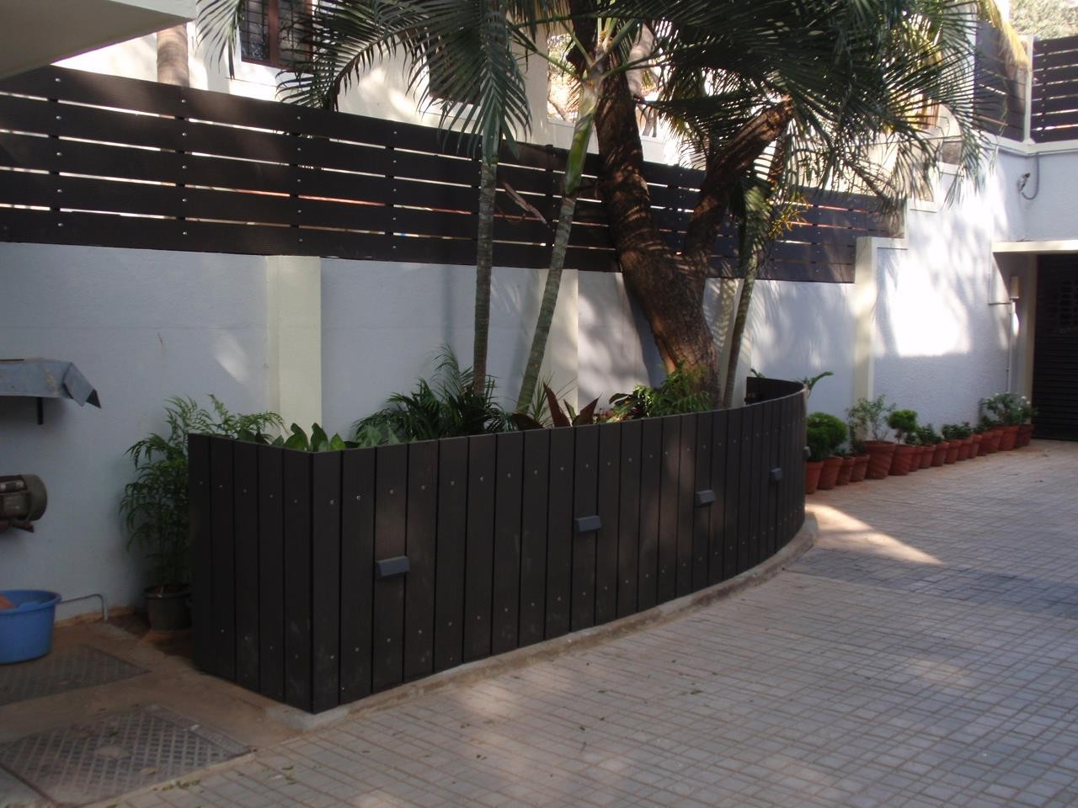
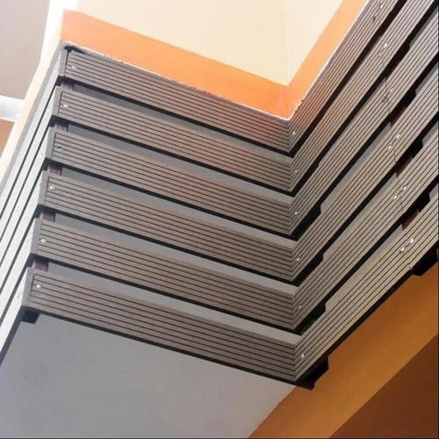
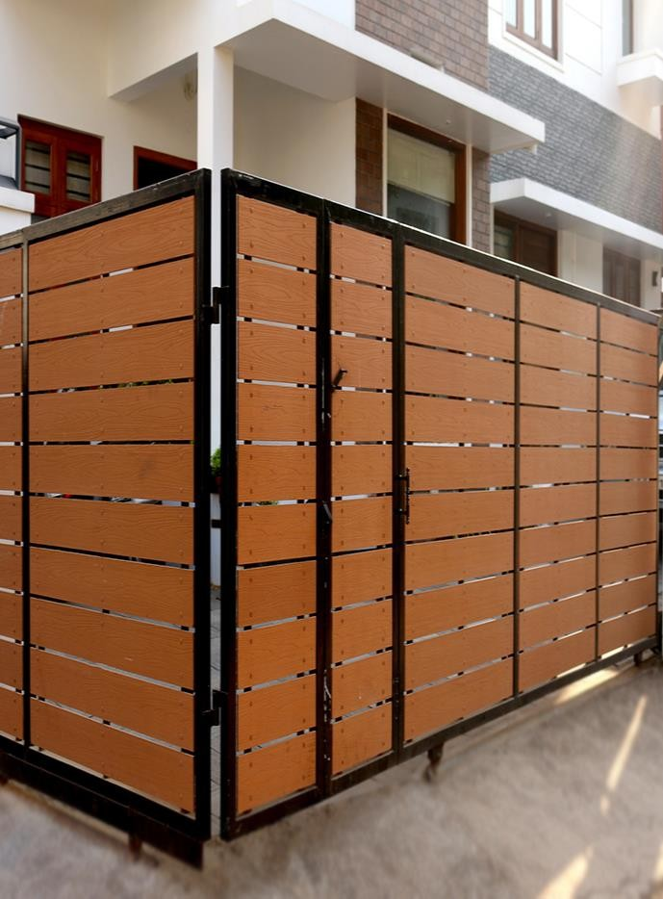
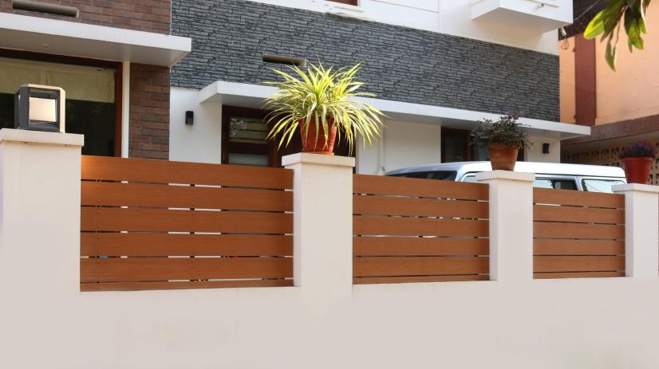
Our Stemwud Wood Plastic Composite plank boards provide a natural- looking, long lasting and easy to maintain surface for outdoor areas. Exterior facade cladding, siding, ceiling, fencing, planter boxes and gates can all benefit from our Louvers.
Our Stemwud Louvers boards feature a solid core construction and are suitable for domestic and commercial use. They are an attractive modern alternative to traditional timber boards that can split and warp and require expensive on-going rot-prevention treatment.
WPC Planks
13

Slide 15
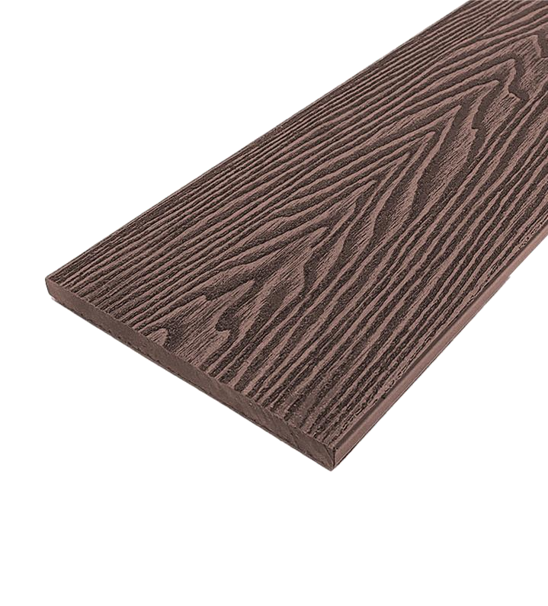
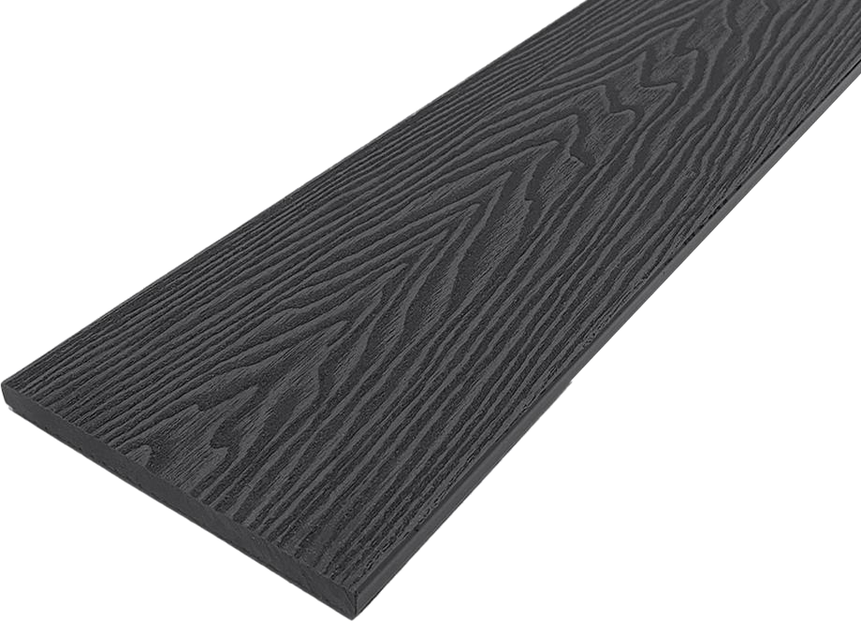
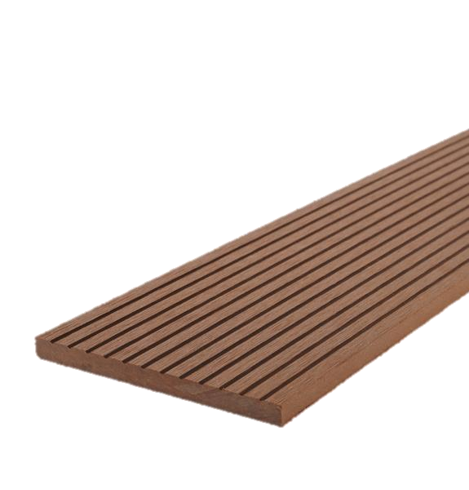
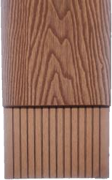



STE M W U D NEO PL A NK S
Size: 146 x 10 x 290 0 m m
Color options
SWP301
Teak
SWP302 D.Grey
SWP303
Chocolate
S P E C I F I C A T I O N S & DIMENSIONS
146
Area per panel | 4.56 sq.ft.
Area per Box | 22.80 sq.ft.
Pcs per Box | 5 Pcs
14

Slide 16
Features and benefits
Durability and weather resistance: WPC is known for its resilience against diverse weather conditions, including heat, cold, rain, and humidity. It's resistant to rotting, warping, fading, and insect damage, offering a longer lifespan compared to traditional wood options. Co-extruded Decking, Louvers and Cladding, like STEMWUD, has an additional outer layer that enhances durability and provides superior protection against UV rays, moisture, scratches, and stains.
Low Maintenance: Unlike wood, WPC, especially co-extruded versions, doesn't require regular staining, sealing, or painting. The outer layer of co-extruded wpc makes it easy to clean and highly resistant to stains.
Aesthetics: WPC cladding mimics the natural look and feel of wood, offering various colors, textures, and finishes. Co-extruded WPC can feature realistic and long-lasting wood grain patterns, providing a natural and authentic appearance.
Sustainability: WPC is often made from recycled materials, including wood fibers and plastic, making it an environmentally friendly choice compared to traditional wood. The use of recycled content reduces the demand for virgin materials and minimizes environmental impact.
Easy Installation: WPC panels can be installed using a straightforward process, including options like hidden fasteners or interlocking panels. Some co-extruded systems even allow for clip-free installation, making the process simpler and potentially reducing labor time and cost.
15

Slide 17
Wpc outdoor fixing
Installing WPC (Wood-Plastic Composite) outdoors
WPC offers a durable and low-maintenance alternative to traditional wood for various outdoor applications, such as decking, cladding, and fencing.
Here's a breakdown of the installation process for WPC outdoor products:
1. Planning and preparation
Measure and Plan: Accurately measure the installation area and create a detailed layout, accounting for any obstacles like doors or windows.
Surface Preparation: Ensure the surface for installation (wall, ground) is clean, dry, and level. Repair any cracks or holes before installation.
Acclimatize the Material: Allow WPC boards/panels to sit at the installation site for at least 48 hours before installation to adapt to the ambient temperature and conditions.
2. Choosing the right WPC and accessories
WPC type: Select the type of WPC (decking, cladding, or fencing) that suits your project and choose the desired color, texture, and finish.
Fasteners: Use appropriate fasteners like WPC clips (for hidden fastening) or self-drilling screws for attaching the WPC to the substructure. Always use anti-corrosive hardware, fixtures, and fasteners.
Joists/Battens: For WPC cladding, use aluminum or wooden battens as the substructure. For decking, select joists (aluminum, wooden, or composite) and ensure proper spacing between them based on the WPC board type.
3. Installation
Build the substructure: Install joists or battens according to your chosen application, ensuring they are level and spaced correctly.
Attach starter clips: Begin by attaching starter clips along one edge or the bottom edge of the frame/joists. These clips create a secure starting point.
Install WPC boards/panels:
16

Slide 18
Decking: Slide the first WPC board into the starter clips and gently tap into place. Continue installing boards, using spacers or clips to maintain expansion gaps between the boards and securing them to the joists with screws or hidden fasteners.
Cladding: Start from the bottom or outside, placing the first board and locking it into the starter clips. Fasten the boards to the joists with screws. Overlap the edges according to the manufacturer's recommendations.
Fencing: Install fence posts into dug holes (or secure to concrete bases), ensuring they are level and spaced correctly. Attach rails between the posts and slide or attach WPC fence panels onto the rails.
Trim and finishing touches: Trim WPC boards/panels to fit around corners, windows, and doors using a saw. Install skirting or trims to cover exposed edges or hollow cavities. Apply caulk or sealant to joints, especially in wet areas.
4. Post-installation and maintenance
Inspect: Check the alignment, stability, and for any visible imperfections after installation.
Clean: Remove dust and debris. Clean the WPC surfaces with a soft brush or cloth and a mild soap and water solution.
Maintenance: While WPC requires less maintenance than natural wood, regular cleaning and occasional inspections for damage can help prolong its lifespan.
Important considerations
Expansion Gaps: WPC expands and contracts with temperature changes, so ensure proper expansion gaps (typically 6-8mm) are left between boards/panels and adjacent surfaces. Failure to do so can lead to warping or bowing.
Manufacturer's Instructions: Always refer to the specific manufacturer's installation guidelines for the WPC product you're using, as different types may have slightly different requirements.
Work in Good Weather: Install on a dry day to minimize moisture interference.
Use Quality Tools: High-quality tools ensure accuracy and efficiency.
By following these guidelines, you can ensure a successful WPC outdoor installation that enhances the beauty and functionality of your space for years to come.
17

Slide 19

Applications Exteriors
FLOOR DECKING
BALCONY DROPS
PARTITION
BENCHES
WALL CLADDING
GATES
FENCING

Slide 20


Applications Exteriors
FALSE CEILING
BALCONY HANDRAILS
DUCT COVERING
COLUMN CLADDING
PLANTER BOX
VENTILATED PARTITIONS / FENCING
DECKING DIY TILES
INTERIOR WALL CLADDING
19

Slide 21








